Slide 1
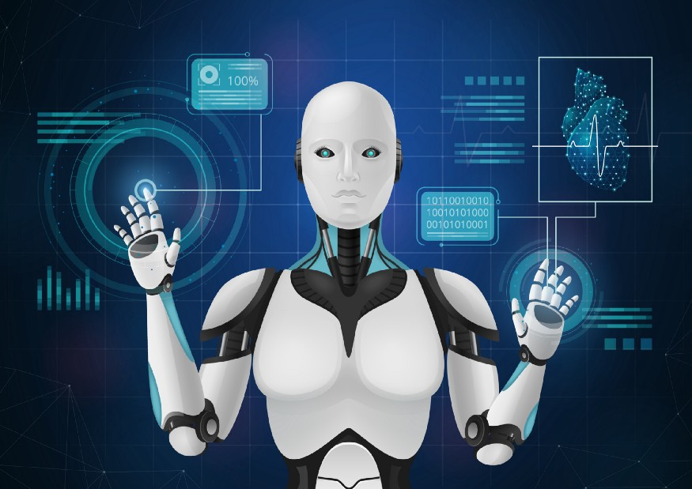
AutoML Introduction (theory)

Slide 2
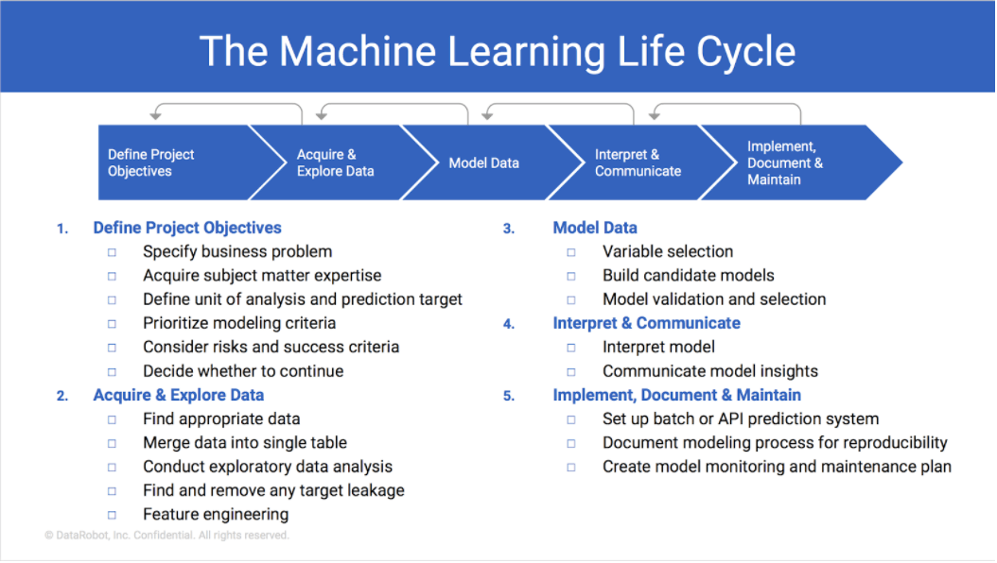
Machine Learning/AI Lifecycle

Slide 3
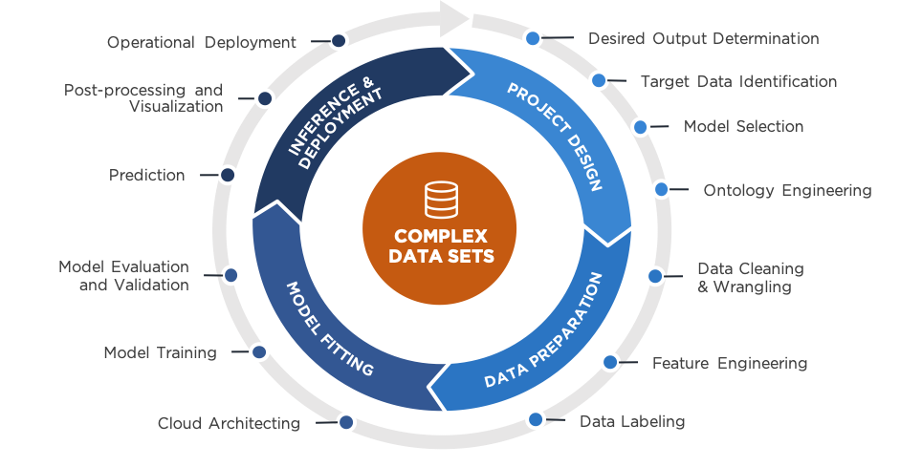
Machine Learning/AI Lifecycle

Slide 4
What is the problem?
Complexity: there is a huge learning gap for those who are not so technical therefor ML/AI is left for people who are competent in some skills.
Inclusivity: by reason of the above, the people, organizations can’t access the advantages of AI.

Slide 5
What is AutoML?
Auto ML stands for “Automated Machine Learning,” and it is a process that automates the entire machine learning workflow, from data pre-processing to model selection and tuning. With Auto ML, the user does not need to have extensive knowledge of machine learning algorithms or programming skills.

Slide 6
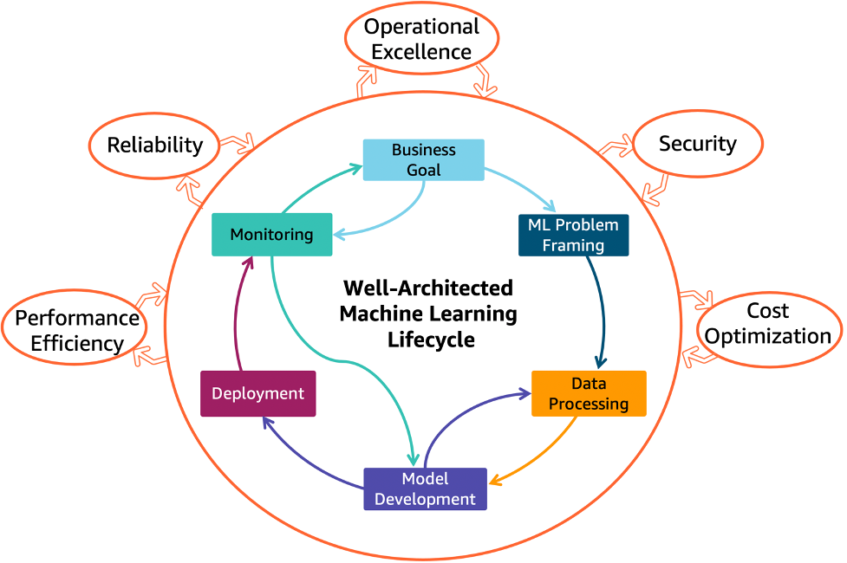

Just imagine…

Slide 7
Auto ML can be divided into three main categories.
Auto Feature Engineering: This category of Auto ML automates the process of creating new features from the raw data. It includes techniques such as feature extraction, feature selection, and feature generation.
Auto Model Selection and Tuning: This category of Auto ML automates the process of selecting the best-performing model among a set of candidate models and tuning its hyperparameters.
Auto-pipeline: This category of Auto ML automates the entire machine learning pipeline, including feature engineering, model selection, and hyperparameter tuning.

Slide 8
Benefits of Auto ML
One of the main benefits of Auto ML is that it can save time and resources. Traditional machine learning requires a lot of data preprocessing, feature engineering, and model selection, which can take weeks or even months.
Another benefit of Auto ML is that it can improve model performance. The system can try multiple algorithms and parameters and select the best-performing model, which can lead to better accuracy and generalization.
Auto ML also helps to democratize the field of machine learning, making it accessible to a wider range of users, including those without a deep understanding of the algorithms and techniques involved.

Slide 9

What AutoML is NOT!
AutoML is not a license for YOU to get lazy so the machine will do everything for you.
The libraries are prone to making mistakes and so they require a human in the loop mechanism to be able to do the job properly.

Slide 10
Introduction to Pycaret (theory)
PyCaret is an open-source, low-code machine learning library in Python that allows you to go from preparing your data to deploying your model within minutes.
It provides a user-friendly interface to perform various tasks such as data cleaning, transformation, feature selection, and model training, etc.
PyCaret also provides an easy way to compare different models and select the best one, as well as the ability to deploy models to production.
PyCaret is designed to increase productivity and lower the entry barrier for people who are new to machine learning, and can be used for classification, regression, clustering, and natural language processing tasks.

Slide 11
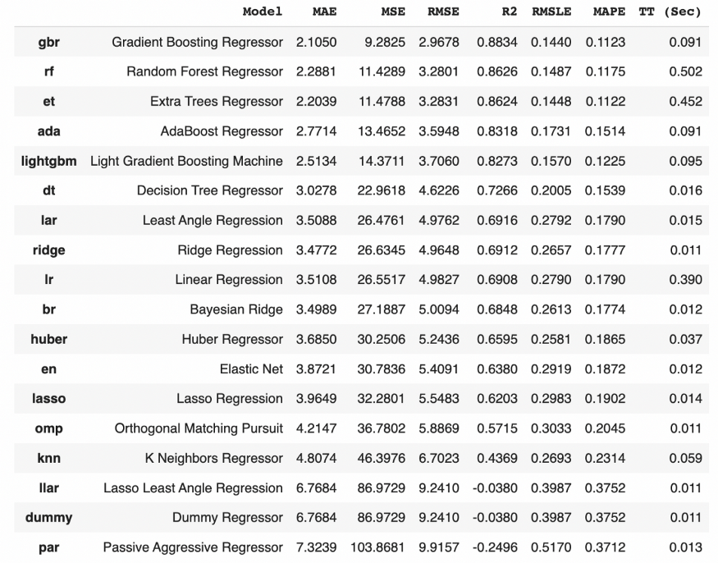
Multiple Models

Slide 12
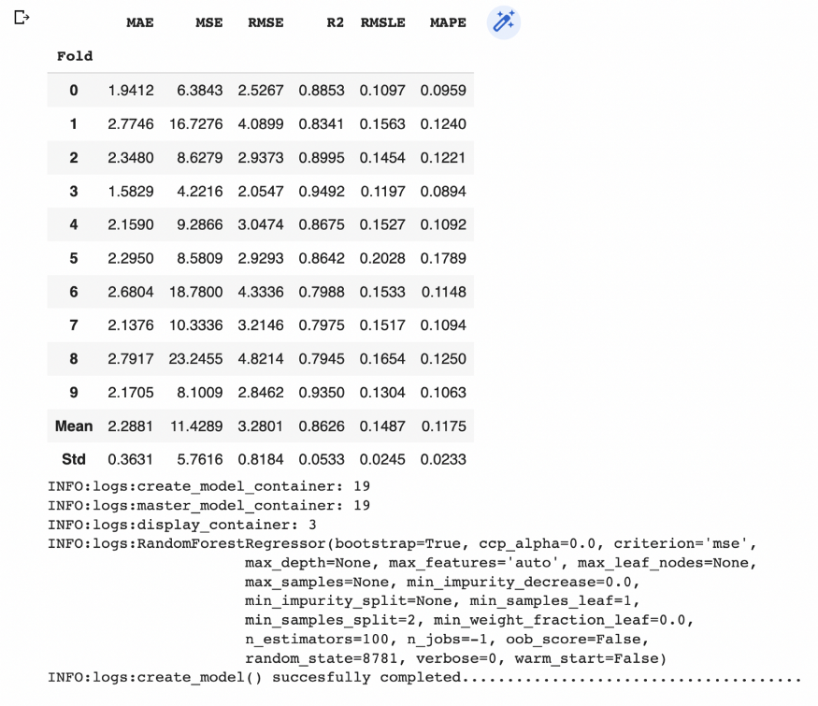
Modeling

Slide 13
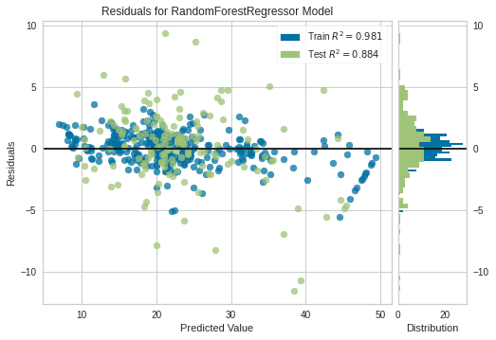
Model Visualization.

Slide 14
To do…
We are going to build a model using the Pycaret Dataset as spoken above in our practical session.
We are going to explore as many functionalities that pycaret offers in the time we have.
We will try to come up with an app that we can use a demo in our pipeline.

